Slide 1
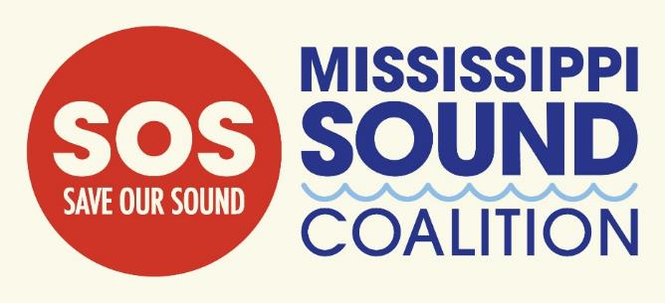
SOUNDING THE ALARM:
Harmful Effects On Dolphins Caused By Polluted Mississippi River Water Released Into Mississippi Sound Through Bonnet Carré Spillway
Dr. Moby Solangi, Institute for Marine Mammal Studies

Slide 2
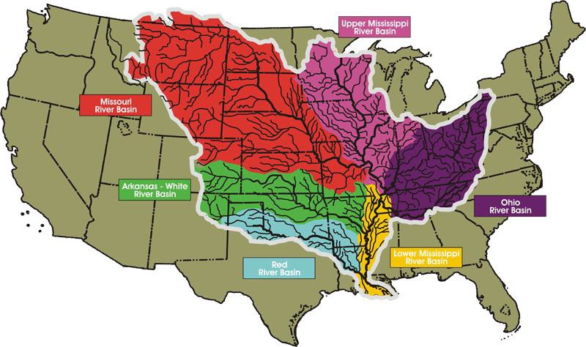
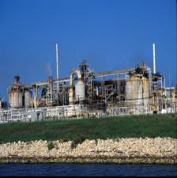
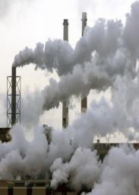
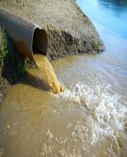
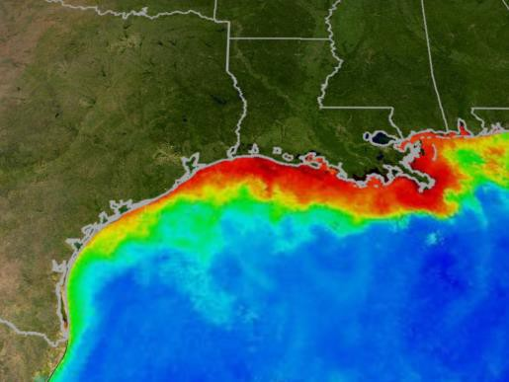
DEAD ZONE
Rivers and tributaries from 31 states flow into the Mississippi River and eventually empty into the Gulf of Mexico and, when the Bonnet Carré Spillway is opened, into Lake Pontchartrain, Lake Borgne and the Mississippi Sound.
Animal waste and agricultural and industrial runoff present in the Mississippi River water drain into the Mississippi Sound, thereby polluting it with contaminants like antibiotics and mercury and nutrients like phosphates and nitrates.
Pollutants in the water travel up the food chain and are ultimately consumed by top predators, including dolphins.
Excess nutrients in the runoff allow algae to bloom, creating hypoxic (low oxygen) conditions and resulting in dead zones. Few organisms can survive under these hypoxic conditions.
At the Mississippi River's mouth is a 10,000 square-mile Dead Zone. The Dead Zone expands every summer, affecting coastal ecosystems from Florida to Texas.

Slide 3
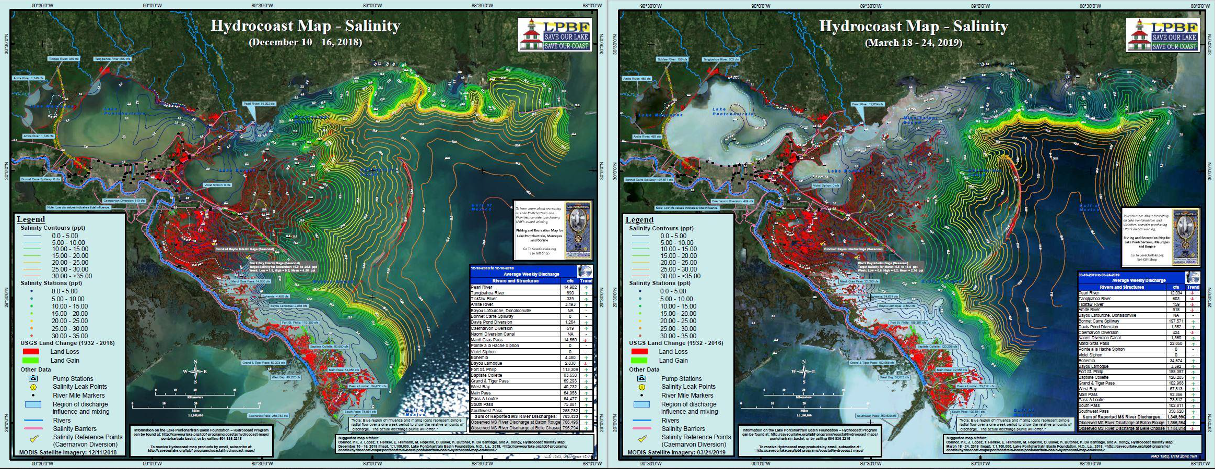
BONNET CARRÉ SPILLWAY 2019
The 2019 opening to relieve pressure on levees – caused polluted,
low-salinity water to pour into Lake Pontchartrain and the Mississippi Sound

Slide 4
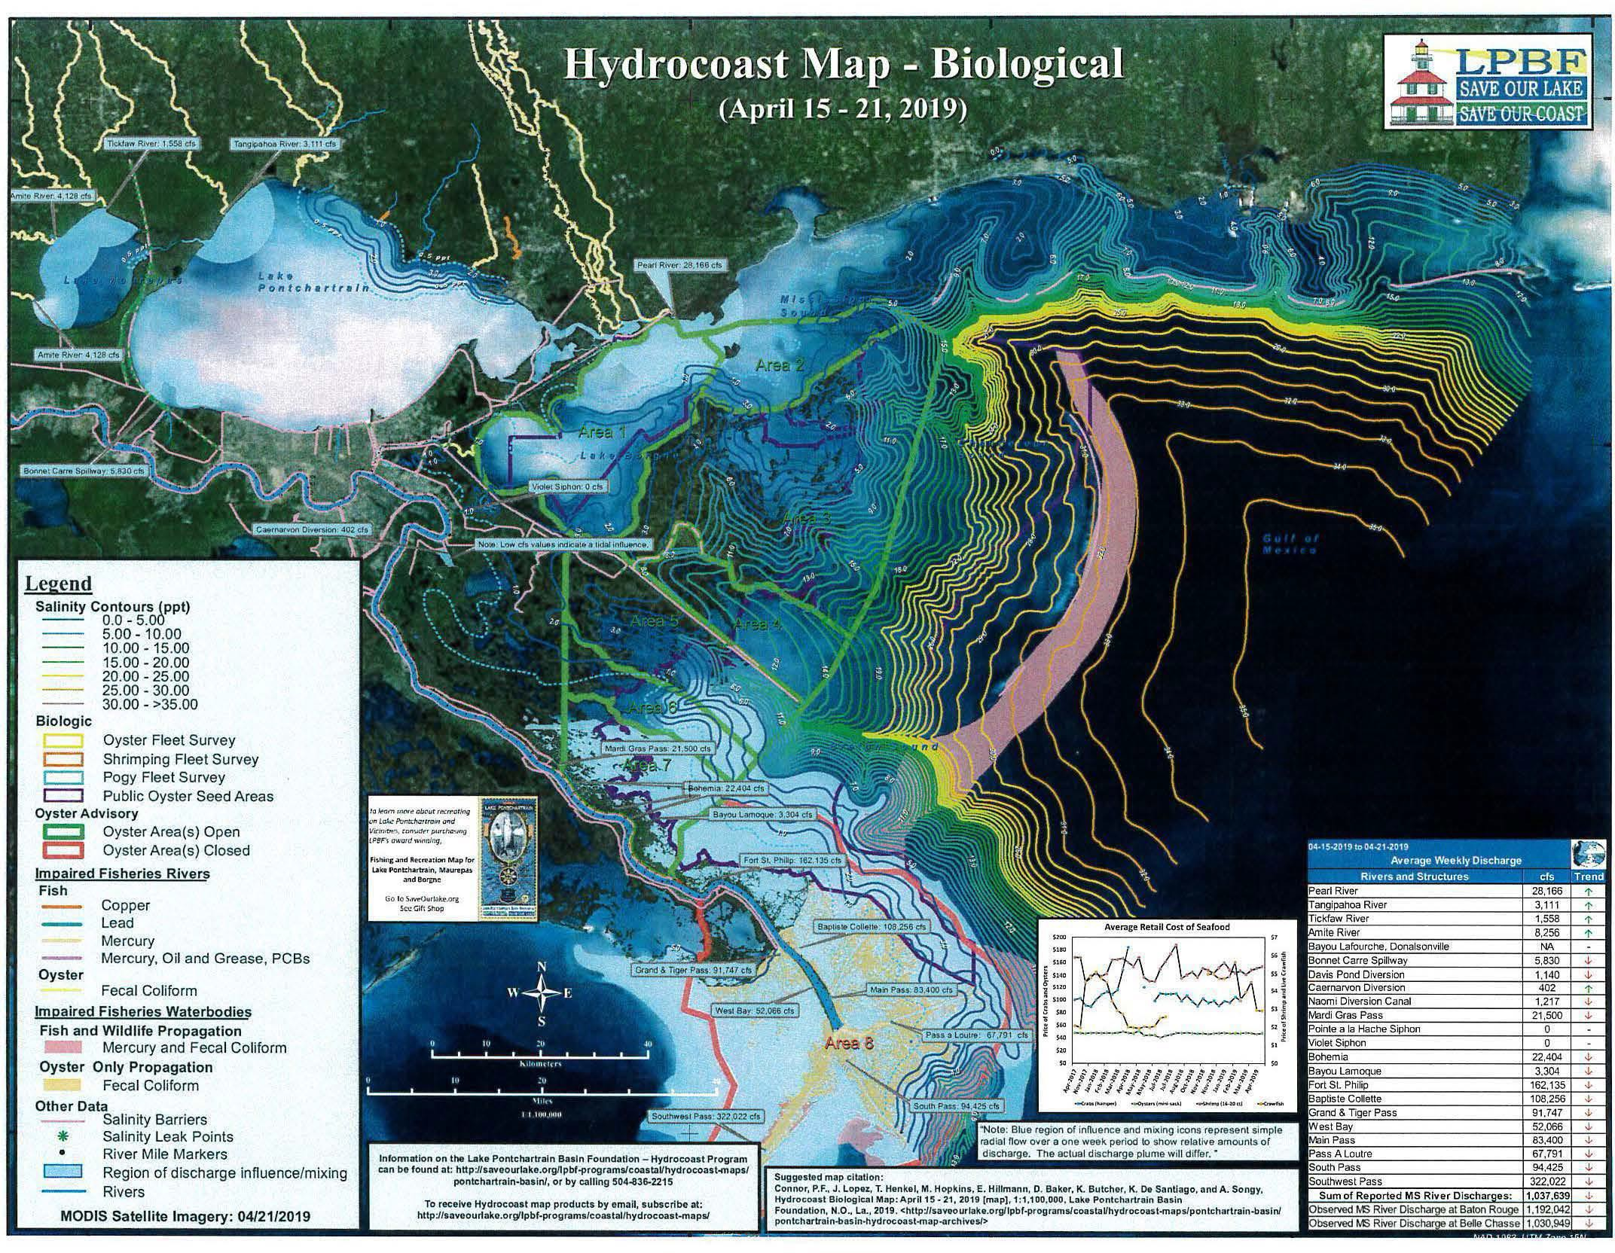
The lighter colors in Lake Pontchartrain and Eastward into the MS Sound depict low-salinity, polluted river water.

Slide 5
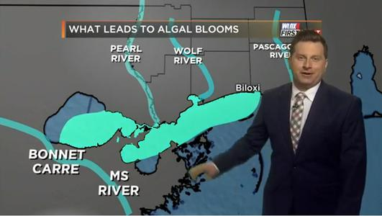
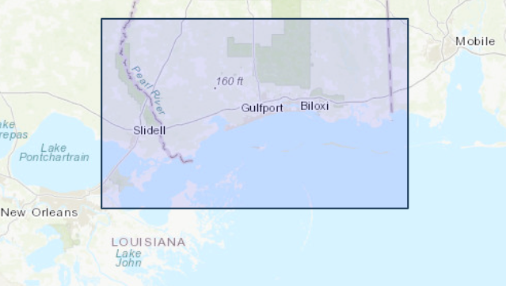
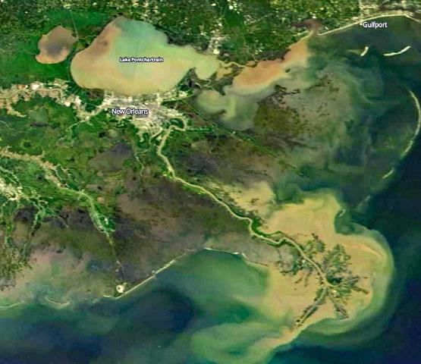
TOXIC ALGAE BLOOM
The Bonnet Carré Spillway opening also resulted in a toxic algal bloom in the MS Sound, which closed beaches, caused economic losses and killed marine life.
Algae-affected areas from Louisiana to Alabama
Algae forced 25 beaches in MS to close June - October 2019

Slide 6
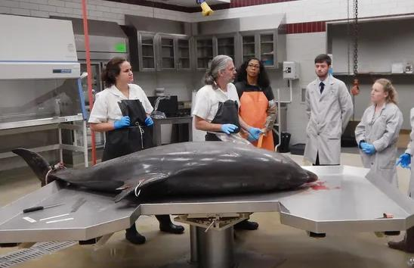
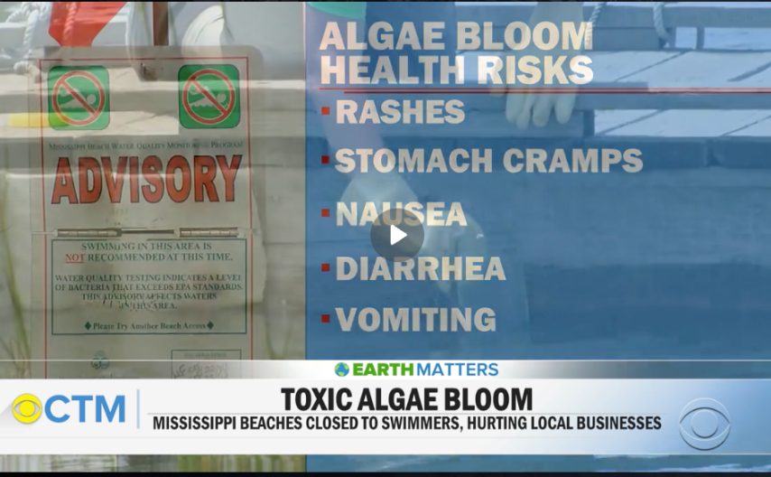
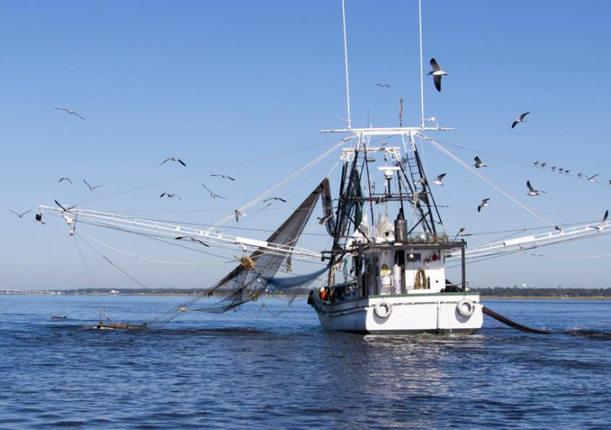
TOXIC ALGAE EFFECTS
Marine Life
Human Life
Way of Life
"It's 128 (dead) dolphins and 154 sea turtles. The dolphins have quite a large number of lesions on them from the low-salinity water.”
- Dr. Moby Solangi , IMMS
(Clarion Ledger – June 7, 2019)
The shrimp industry has never seen a worse season. Not only from the effects of the Bonnet Carré on the ecosystem, but the algae warnings for seafood have been detrimental to their business.
(Jerry Forte Seafood, The Sun Herald – August 6, 2019)

Slide 7
Dolphin & Sea Turtle Deaths Caused By Bonnet Carré Openings (2011-2020)
Overall Openings |  |  |  |  |  | Volumes of River Water | Mortalities
Number of | Year | Date | Days Open | (%) Opened | Discharge | Volume (gallons) | Dolphin Mortalities | Turtle Mortalities
Openings |  | Opened |  |  | (cfs)
1 | 1937 | 28-Jan | 48 | 81.40% | 203,571 | 6,315,831,640,627 | -
2 | 1945 | 23-Mar | 57 | 100% | 250,000 | 9,210,607,200,000 | -
3 | 1950 | 10-Feb | 38 | 100% | 250,000 | 6,140,404,800,000 | -
4 | 1973 | 8-Apr | 75 | 100% | 250,000 | 12,119,220,000,000 | -
5 | 1975 | 14-Apr | 13 | 64.30% | 160,714 | 1,350,424,970,669 | -
6 | 1979 | 17-Apr | 45 | 100% | 250,000 | 7,271,532,000,000 | -
7 | 1983 | 20-May | 35 | 100% | 250,000 | 5,655,636,000,000 | -
8 | 1997 | 17-Mar | 31 | 85.10% | 212,857 | 4,265,039,208,413 | -
9 | 2008 | 11-Apr | 31 | 45.70% | 114,286 | 2,289,961,199,174 | -
- | 2010 | BP Oil Spill |  |  |  |  | 91 | 309
10 | 2011 | 9-May | 42 | 94.30% | 235,714 | 6,398,940,403,699 | 147 | 266
- | 2012 | - | - | - | - | - | 48 | 154
- | 2013 | - | - | - | - | - | 49 | 209
- | 2014 | - | - | - | - | - | 48 | 147
- | 2015 | - | - | - | - | - | 33 | 61
11 | 2016 | 10-Jan | 22 | 60.00% | 203,000 | 2,886,636,614,400 | 82 | 136
- | 2017 | - | - | - | - | - | 51 | 62
12 | 2018 | 8-Mar | 22 | 48.00% | 196,000 | 2,787,097,420,800 | 51 | 123
13 | 2019 | 27-Feb & | 123 | 58.90% | 213,000 | 10,366,942,377,600 | 153 | 201
 |  | 10-May
14 | 2020 | 3-April through 30-April | 28 |  |  | 1,005,000,000,000 | 58 | 113
Note: Areas highlighted in yellow show years in which the spillway was open since 2011, and dolphin and sea turtle deaths are documented.

Slide 8
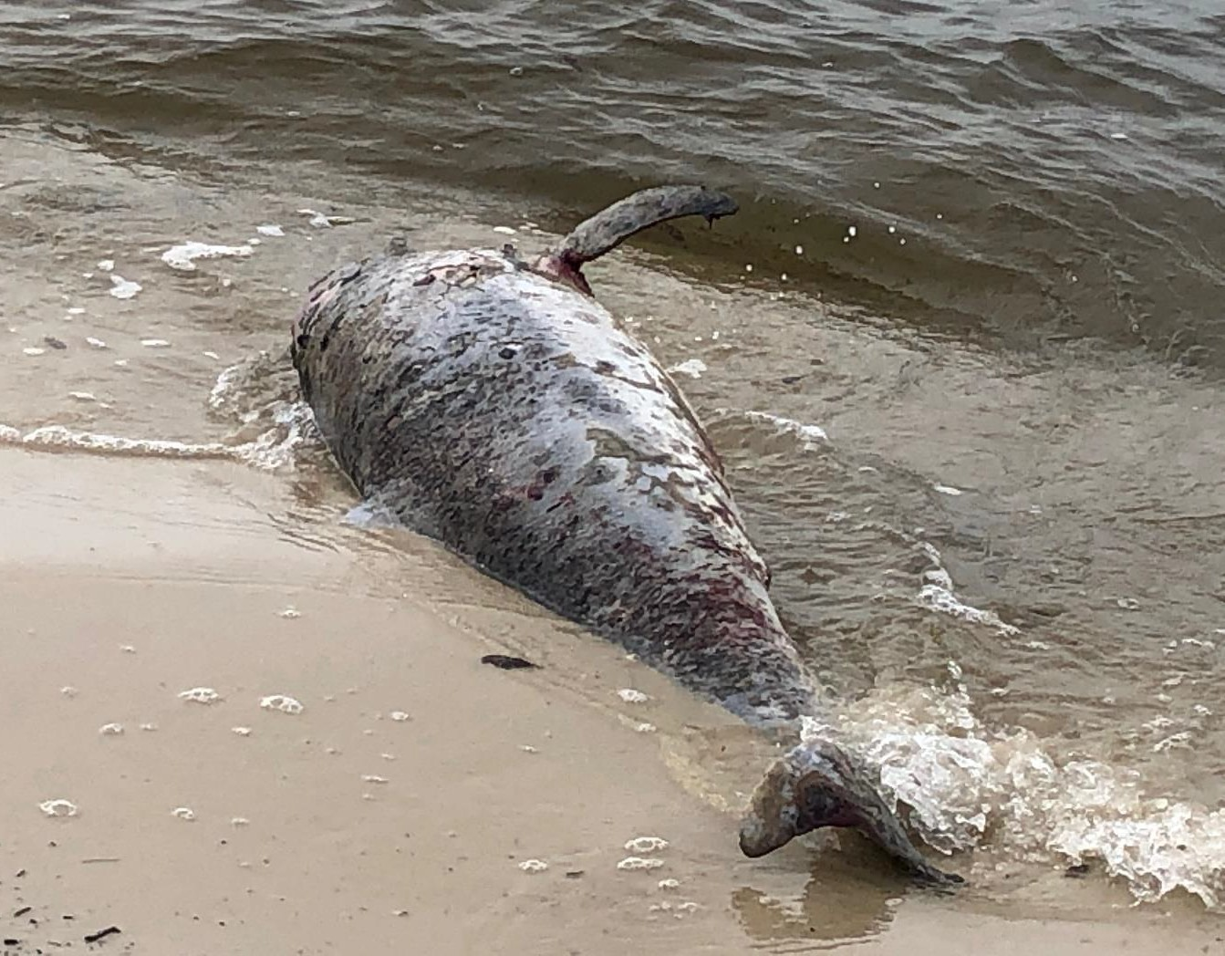
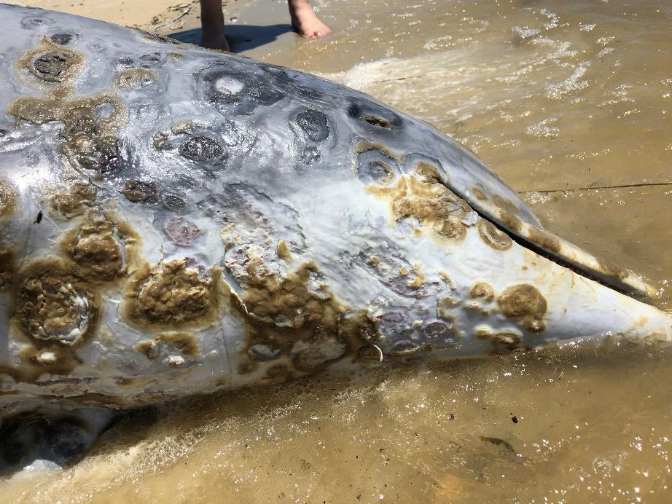
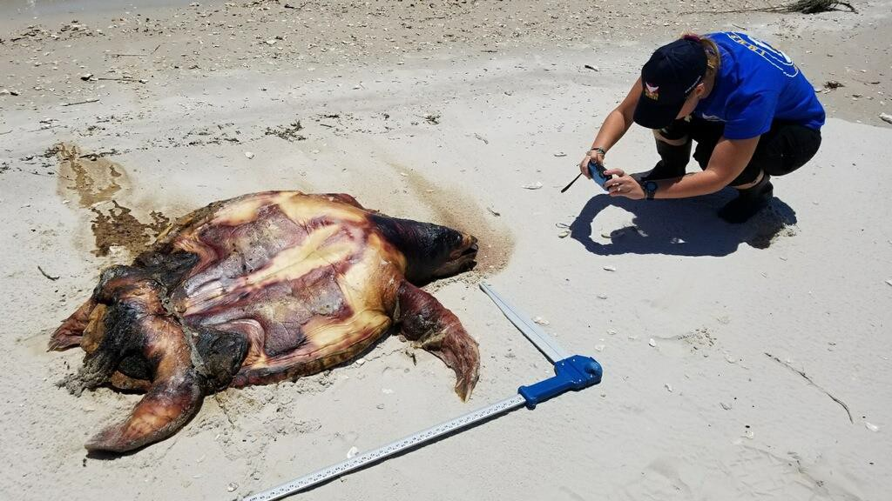

Slide 9
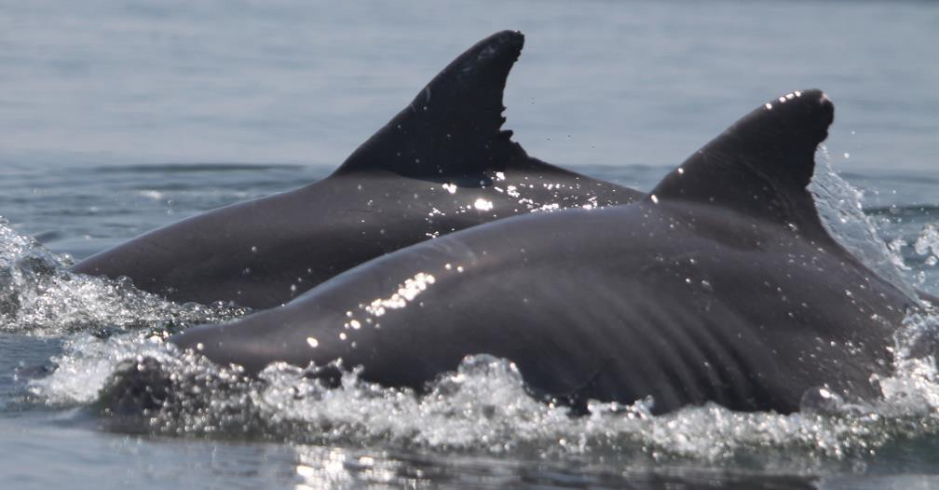
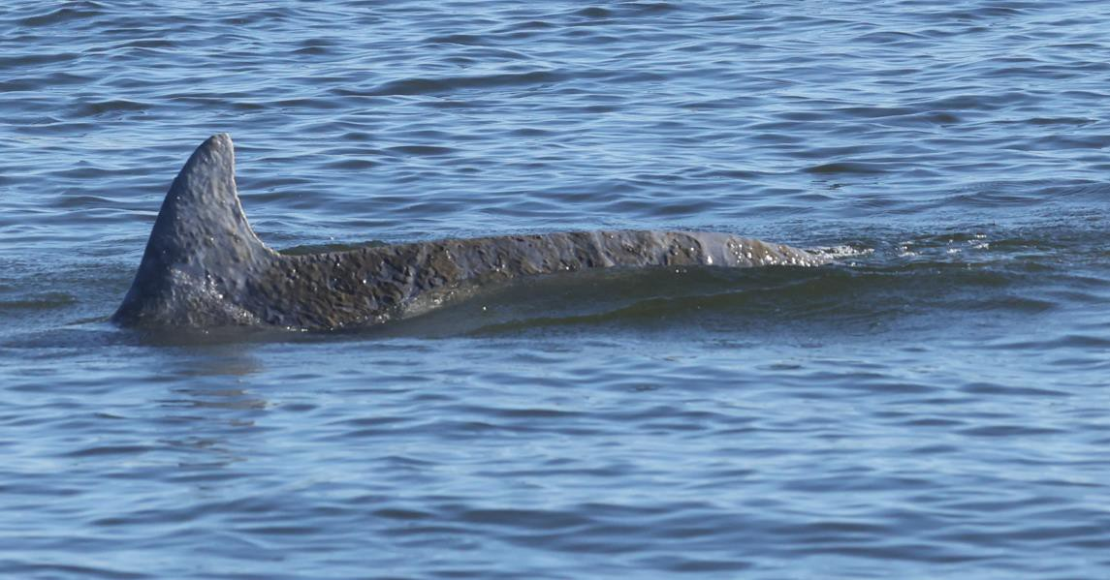
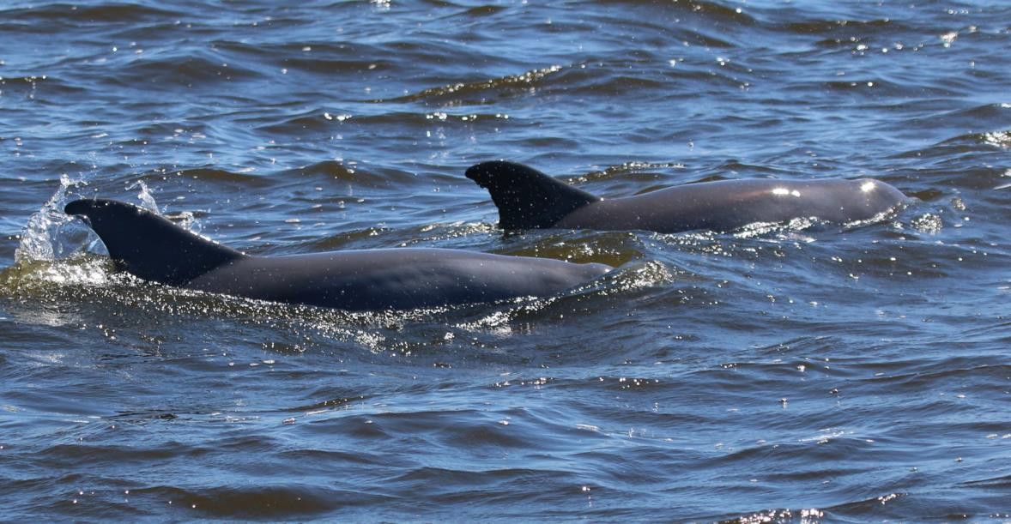
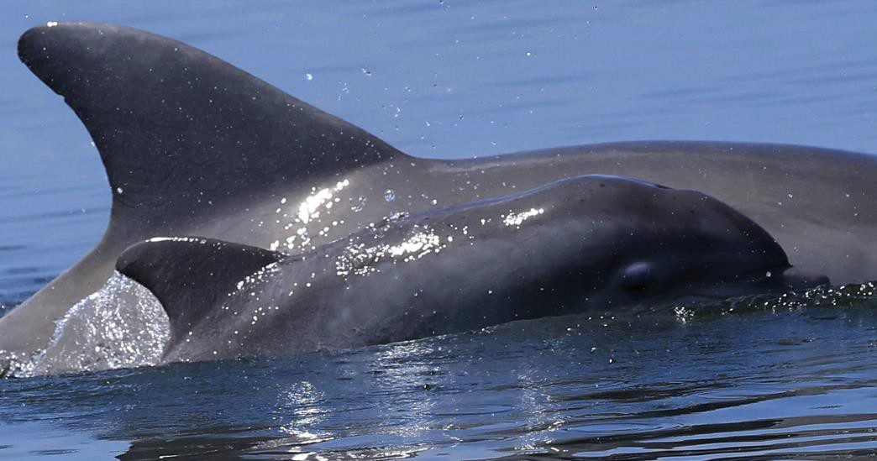
Effects of Bonnet Carré Spillway Discharges on Dolphin Health
Malnutrition Fresh Water Lesions

Slide 10
SUMMARY
The Mississippi River is highly polluted and is not an indigenous river connected to the MS Sound.
The diversion of polluted Mississippi River water into the MS Sound has and will continue to cause serious and long-term damage to the ecosystem, resulting in losses to marine mammals, fisheries and the economy.
The Mississippi River diversions of low-salinity, polluted water into the MS Sound are contrary to the Endangered Species Act, the Marine Mammal Protection Act, and the Magnuson-Stevens Act.
A complete, independent EIS should be conducted by the Corps ASAP regarding the operation of all Mississippi River flood control structures – and before any construction permits are issued for new diversions.
The Corps has the authority to consider other options for the management of the Mississippi River in ways that would protect people and property from flooding without killing the dolphins in the Mississippi Sound.

